Slide 1
Basic Facts and Computations
Building Fluency and Conceptual Understanding
Middle School Level
Copyright © 2016 American Institutes for Research. All rights reserved.

Slide 2
Developing an Understanding of the DBI Process
Handout #1

Slide 3
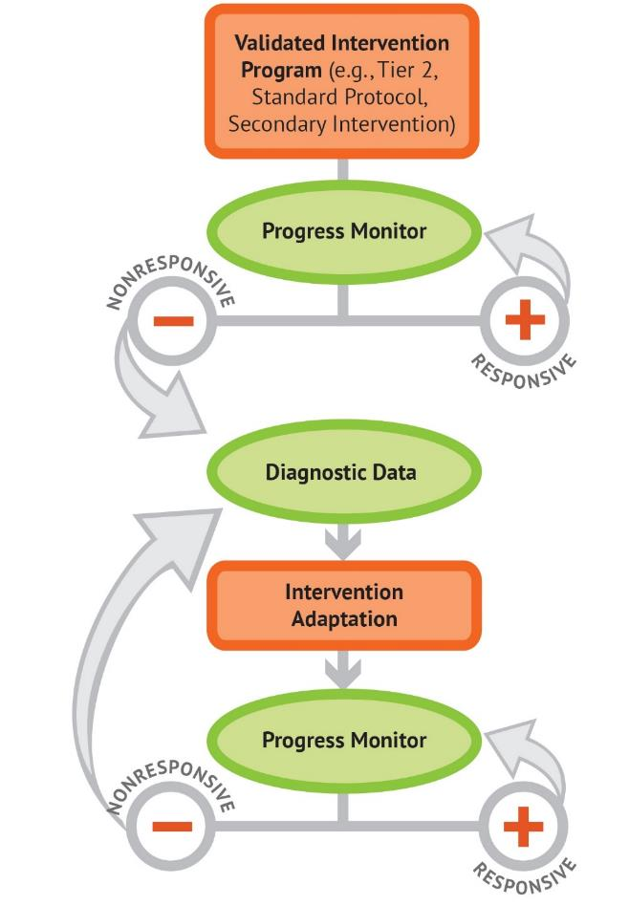
The DBI Process

Slide 4
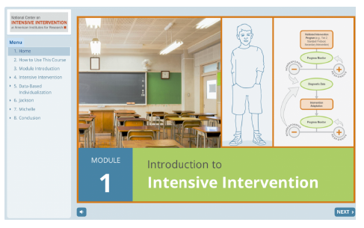
Introduction to Intensive Intervention
For additional information on the DBI process, check out the Introduction to Intensive Intervention module.
The self-paced module:
Defines intensive intervention and DBI;
Describes how intensive intervention fits within a tiered system such as MTSS (multi-tiered system of supports), RTI (response to intervention), or PBIS (positive behavior intervention and supports); and
Demonstrates how intensive intervention can provide a systematic process to deliver specialized instruction for students with disabilities.
https://intensiveintervention.org/resource/self-paced-introduction-intensive-intervention

Slide 5
Characteristics of Instruction Across the Tiers
 | Primary (T1) | Secondary (T2) | Intensive (T3)
Instruction/ Intervention Approach | Comprehensive research-based curriculum | Standardized, targeted small-group instruction | Individualized, based on student data
Group Size | Classwide (with some small-group instruction) | 3–7 students | No more than 3 students
Monitor Progress | Once per term | At least once per month | Weekly*
Population Served | All students | At-risk students | Students with significant and persistent learning needs
DBI is an approach to intensive intervention.
* Or as indicated by the assessment instructions.

Slide 6
Five DBI Steps
Secondary intervention program, delivered with greater intensity
Progress monitoring
Informal diagnostic assessment
Adaptation
Continued progress monitoring, with adaptations occurring whenever necessary to ensure adequate progress

Slide 7
Mathematics Facts
Handout #2

Slide 8
Why do students struggle with math facts?
Ineffective strategy use
Weaknesses in the following:
Retrieval or fluency
Procedures
Higher level or conceptual understanding
Arithmetic relations among numbers
Working memory can affect a child’s ability to apply strategies to effectively solve whole-number computations and word problems
Sources: Geary, 1993, 2005; Gray, Pinto, Pitta, & Tall, 1999; Impecoven-Lind & Foegen, 2010; Jayanthi, Gersten, & Baker, 2008; Hecht, Close, & Santisi, 2003; Raghubar, Barnes, & Hecht, 2009; Swanson & Jerman, 2006; Swanson, Jerman, & Zheng, 2008

Slide 9
What is expected of students?
Third-grade students demonstrate mastery, defined as at least 80% accuracy
Addition and subtraction facts
Products of two 1-digit numbers
Beyond basic fact mastery, students must extend fact knowledge to application of multistep problems involving different operations (CCSS-M & NCTM, 2014; NMAP, 2008)
Sources: National Governors Association Center for Best Practices & Council of Chief State School Officers: Common Core State Standards for Mathematics (CCSS-M) & NCTM, 2014; National Mathematics Advisory Panel (NMAP), 2008

Slide 10
Role of Facts in Middle School
Review fact strategies beginning with addition/subtraction, then multiplication/division
Addition and subtraction
If student can explain an efficient strategy, practice mixed problems.
Set a realistic goal.
Determine whether student understands regrouping.
If older than Grade 6, may want to consider calculator for addition and subtraction.
Multiplication and Division
Review effective strategies systematically.
Set a realistic goal.
Practice daily.
Provide practice and support in using multiplication chart beyond basic facts.

Slide 11
Vocabulary for Teaching Facts and Computation
Handout 33

Slide 12
Vocabulary List
Brainstorm a list of words you use when teaching facts and computation.
READY
SET
GO!

Slide 13
Activity
Student-friendly definition:
Picture or symbol:
Example:
Nonexample:

Slide 14
Mathematics Vocabulary: Best Practices
Direct, Explicit Teaching
Student-friendly definition
Examples and nonexamples
Graphic organizers
Vocabulary charts
Use in a Meaningful Context
Preteach
Model correct vocabulary during explanations
Practice the vocabulary in context
Create word walls or other vocabulary visuals for reinforcement
Review and reinforce correct mathematics vocabulary

Slide 15
Fact Strategies and Progression
Handout #4

Slide 16
Fact Progression: Addition and Subtraction
Fact Strand | Strategy
Part-part-whole: foundational skills | Break apart whole number, no mathematical symbols.
+/-0 | 0 rule: “Any number plus or minus a zero always equals that number.”
+/-1, 2, 3, 4 | Count on and count back.
Doubles and related | Count by 2s.
Doubles +1 and related | Identify the number that is less, double this number, and then add 1 more.
Make 10 and related | Using ten-frames to build mastery and memorization of facts that total 10.
Ten plus more and related | Using place value to show a group of 10 and more.
Make 10 plus more and related | Identify the greater number and make 10 from the lesser valued number.

Slide 17
Fact Progression: Multiplication and Division
Fact Strand | Strategy | Example
×/÷ 0, 1 | Generalization or rule | Any number multiplied with 0 equals 0. Any number multiplied by 1 equals that number.
×/÷ 2, 5, 10 | Skip count | 2 × 6 = 2, 4, 6, 8, 10, 12
×/÷ 9 | Make 10 minus the factor | 9 × 7 = (10 – 1) × 7 (10 × 7) – (1 × 7) 70 ­– 7 = 63
×/÷ 4/8 | Double it two times/double it three times | 4 × 7 = (2 × 2) × 7 2 × 2 × 7 = 2 × 14 2 × 14 = 28

Slide 18
Fact Progression: Multiplication and Division
Fact Strand | Strategy | Example
×/÷ 6 | Break apart 6 and then put back together or double it three times | 6 × 8 = (1 + 5) × 8 (1 × 8) + (5 × 8) = 8 + 40 = 48
×/÷ 7 | Break apart 7 and then put back together | 7 × 6 = (5 + 2) × 6 (5 × 6) + (2 × 6) = 30 + 12 = 42
×/÷ 3 | Break apart 3 and then put back together or count by | 3 × 8 = (2 + 1) × 8 (2 × 8) + (1 × 8) = 8 + 16 = 24

Slide 19
Teaching Multidigit Computation
From Basic Facts to Multistep
Handout #5

Slide 20
Multidigit Operation Computations and Types of Errors
Addition and subtraction
With and without regrouping
With and without decimals
Fractions
Multiplication and division
Multidigit
With and without decimals
Fractions
Integers
Adding and subtracting
Multiplication and division

Slide 21
Computations: Errors and Misconceptions
Overarching errors
Procedural errors
Fact errors
Strategy error
Misconception
Beliefs or faulty thinking that students form from hearing incorrect math or being taught shortcuts that remove math concept development
More conceptual in nature

Slide 22
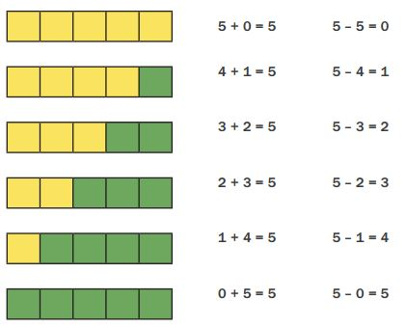
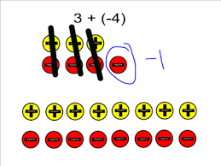
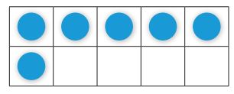
Instructional Progression: Evidence-Based Practices
Multiple representations
When a new strategy is introduced, it is best to start with the concrete representation(s)
Link concrete to part-part-whole mat, number lines, groups, integer chips/zero pairs
Move to a symbolic or pictorial representation(s)
Including number lines, ten-frames, pictures of the manipulatives
Abstract or equations alone

Slide 23
Scaffolding Within DBI
The scaffold, as it is known in building construction, has the following five characteristics:
It provides a support.
It functions as a tool.
It extends the range of the worker.
It enables a worker to accomplish a task not otherwise possible.
It is used to selectively aid the worker where needed (Greenfield, 1999, p. 118).
Types of instructional scaffolds
Teacher or peer
Content and task
Materials

Slide 24
Teacher and Peer Scaffolds
Address prerequisite skills
Preview new skills
Types of questions or clarification questions
Including follow-up questions
Teach students to ask questions and explain thinking
Moves conversations away from only teacher–student to student–student
Reduce the “step size” from one idea or representation to the next
Teach the use of cognitive strategies

Slide 25
Content and Task Scaffolds
Build sequence of skills to introduce easier concepts first
Increase difficulty based on data
Use of high probability to develop worksheets
Sequence instruction so teacher models and then decreases role as lesson continues
Guide students to work with one another; reciprocal teaching

Slide 26
Material Scaffolds
Types and sequences of manipulatives
Counters
Number lines
Ten-frames
Part-part-whole mats
Base 10 materials
Use of games and puzzles
Linking instruction to word walls
Use of technology

Slide 27
Strategies: Addition and Subtraction
Connect to basic facts
Systematic practice
Create multidigit problems containing facts already mastered
Focus on the conceptual understanding rather than facts
Link operations through fact family
Use multiple representations to develop the understanding of how addition and subtraction are connected
Practice addition and subtraction together, as a means to check work, as well as to develop mastery

Slide 28
Strategies: Addition and Subtraction
Isolate the place-value columns.
28 2 tens 8 ones
+14 + 1 ten 4 ones
42 3 tens 12 ones = 4 tens, 2 ones
Connect to powers of 10 to help identify patterns within place value.
2 20 200
+3 +30 +300
5 50 500
Mix problems that require regrouping with those that do not.

Slide 29
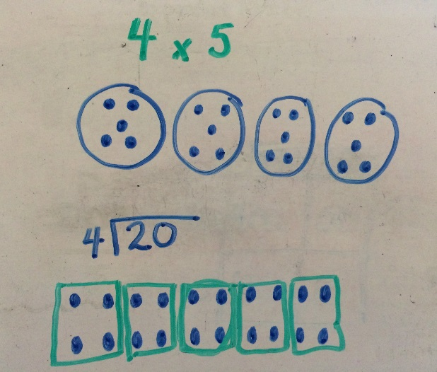
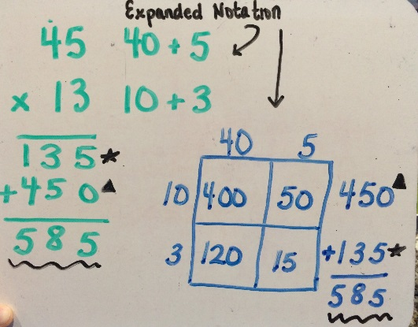
Strategies: Multiplication and Division
Connect to basic facts
Systematic practice
Create multidigit problems containing facts already mastered
Focus on the conceptual understanding rather than facts
Link operations through fact family
For division, think multiplication
Show how the operations are related
Show and explain the traditional algorithm

Slide 30
Case Examples: Error Analysis
Identifying Error Patterns to Help Individualize Instruction
Handout #6

Slide 31
Case Examples
Complete the table for each student.
Identify the type of error
Fact error/procedural error
Conceptual or misconception
What evidence do you have to justify the type of error?
What instructional adaptations are necessary?

Slide 32
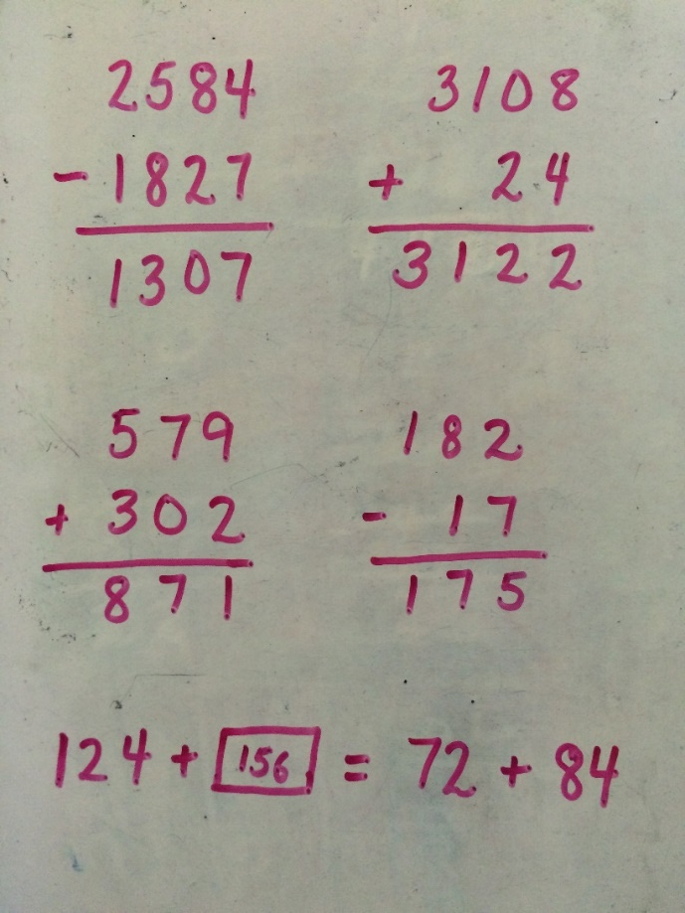
Case Example 1

Slide 33
Case Example 1
Type of Error | What Evidence? | Instructional Adaptation(s)

Slide 34
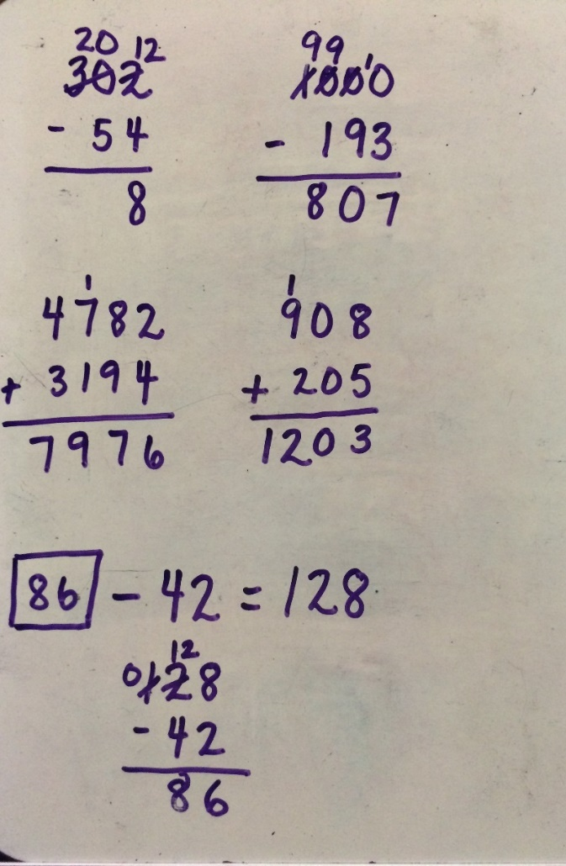
Case Example 2

Slide 35
Case Example 2
Type of Error | What Evidence? | Instructional Adaptation(s)

Slide 36
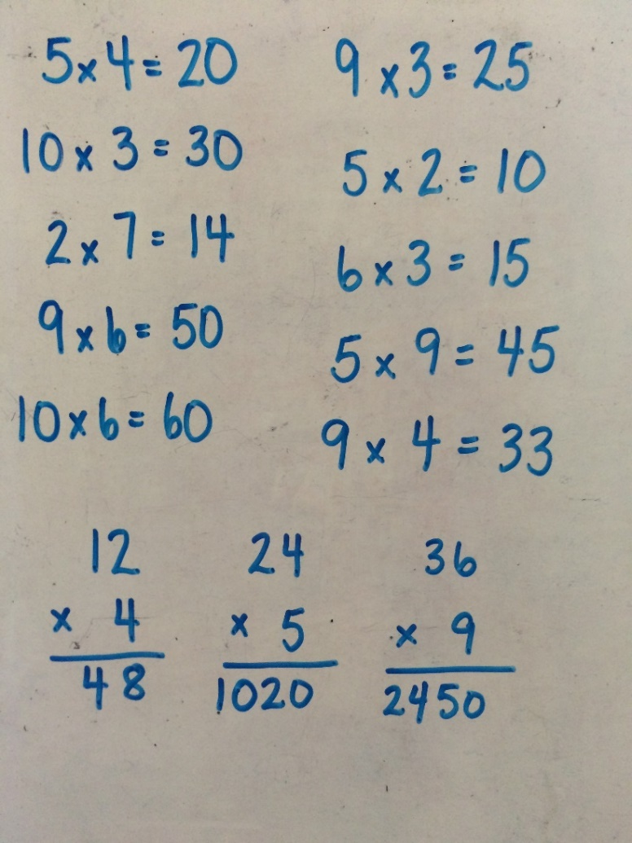
Case Example 3

Slide 37
Case Example 3
Type of Error | What Evidence? | Instructional Adaptation(s)

Slide 38
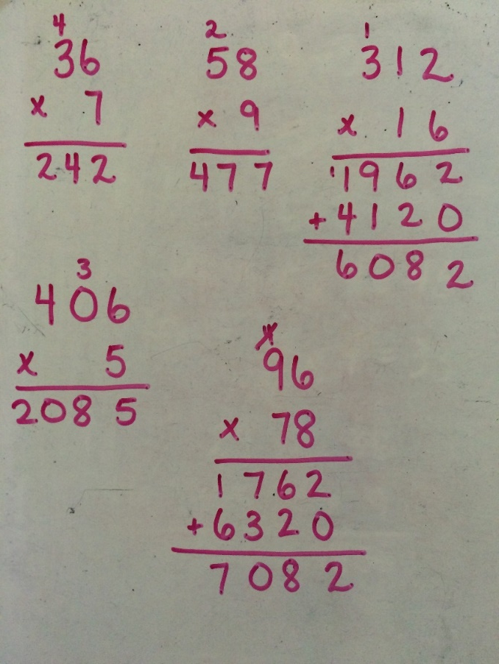
Case Example 4

Slide 39
Case Example 4
Type of Error | What Evidence? | Instructional Adaptation(s)

Slide 40
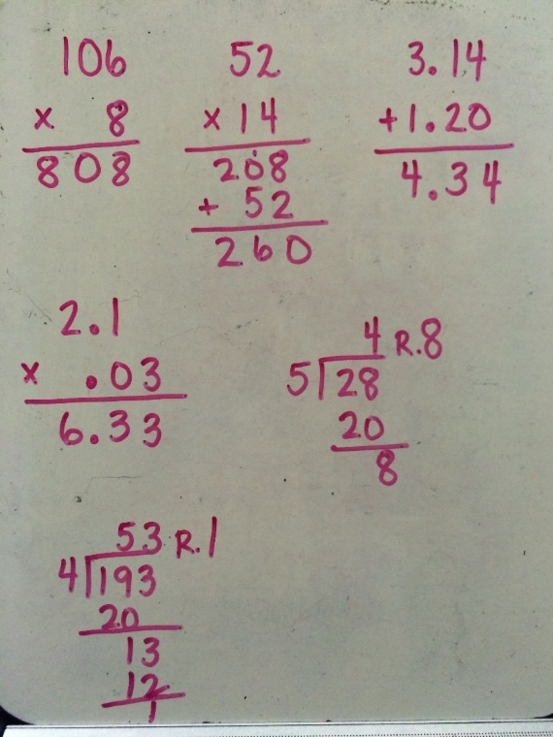
Case Example 5

Slide 41
Case Example 5
Type of Error | What Evidence? | Instructional Adaptation(s)

Slide 42
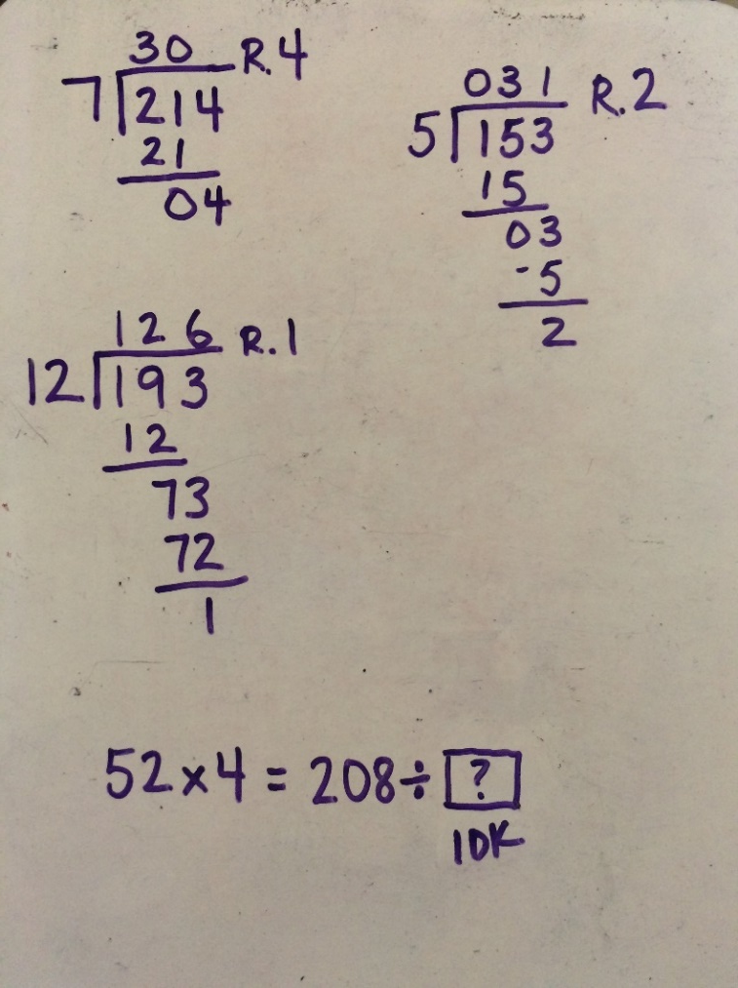
Case Example 6

Slide 43
Case Example 6
Type of Error | What Evidence? | Instructional Adaptation(s)

Slide 44
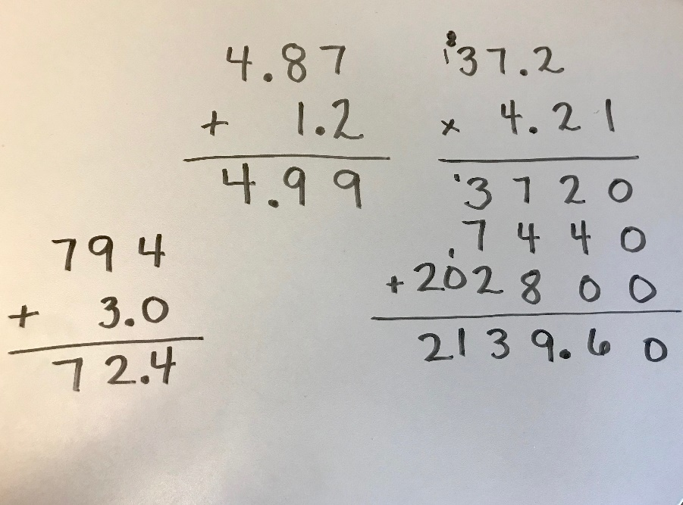
Case Example 7

Slide 45
Case Example 7
Type of Error | What Evidence? | Instructional Adaptation(s)

Slide 46
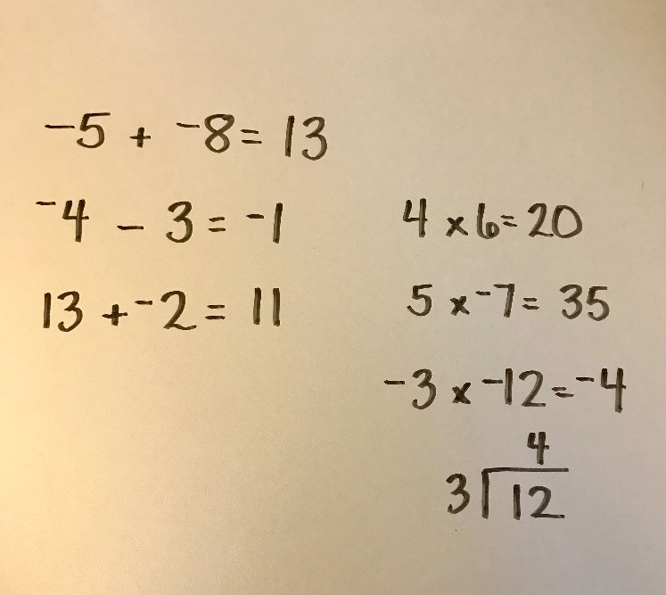
Case Example 8

Slide 47
Case Example 8
Type of Error | What Evidence? | Instructional Adaptation(s)

Slide 48
Case Examples: Class Analysis
Identifying Common Trends in Data to Drive Class Instruction and to Identify Students in Need of More Intensive Intervention
Handout #7

Slide 49
HELP!
The teacher has to design the intervention class to meet the needs of the 10 students.
Provide the following support by answering each question:
How should the teacher group the students?
Which fact strand should each student or group practice daily? How did you make this determination?
Thinking about the skills at grade level, where do you think the students will have the greatest challenge?
On which prerequisite skills should intervention groups focus?
What do you think will be the greatest challenge for this teacher?

Slide 50
Class A: Grade 6
Math Fact Progress Monitoring (total correct)
100 facts per page; 1-minute timed test
Student Name | Addition | Subtraction | Multiplication | Division
Linda | 45 | 32 | 10 | 5
Saleh | 75 | 62 | 15 | 12
Isabel | 90 | 85 | 40 | 33
John | 82 | 54 | 15 | 8
Brad | 78 | 80 | 22 | 18
Krystal | 98 | 97 | 65 | 46
Riley | 90 | 32 | 71 | 22
Kevin | 59 | 58 | 26 | 21
Ethan | 93 | 89 | 70 | 61
Jenna | 21 | 18 | 3 | 2

Slide 51
Class A: Grade 6
AIMSWeb, BOY results on grade level
Student Name | M-Comp—Raw Score | M-Comp—Percentile
Linda | 5 | 11th
Saleh | 11 | 23rd
Isabel | 19 | 50th
John | 5 | 11th
Brad | 22 | 20th
Krystal | 30 | 73rd
Riley | 19 | 50th
Kevin | 12 | 25th
Ethan | 29 | 70th
Jenna | 0 | 0

Slide 52
Class B: Grade 7
Math Fact Progress Monitoring (total correct)
100 facts per page; 1-minute timed test
Student Name | Addition | Subtraction | Multiplication | Division
Elaine | 13 | 8 | 2 | 1
Finn | 92 | 89 | 40 | 32
Lindsey | 87 | 75 | 48 | 36
Thomas | 40 | 41 | 28 | 17
Lauren | 74 | 70 | 55 | 48
Robin | 68 | 62 | 39 | 23
Jackson | 100 | 98 | 71 | 54
Payton | 43 | 52 | 29 | 12
Misty | 89 | 76 | 50 | 48
Ben | 92 | 87 | 51 | 50

Slide 53
Class B: Grade 7
AIMSWeb, BOY results on grade level
Student Name | M-Comp—Raw Score | M-Comp—Percentile
Elaine | 1 | 1st
Finn | 12 | 27th
Lindsey | 12 | 27th
Thomas | 8 | 20th
Lauren | 10 | 25th
Robin | 8 | 3rd
Jackson | 23 | 52nd
Payton | 4 | 8th
Misty | 7 | 18th
Ben | 5 | 10th

Slide 54
Conclusion
Handout #8

Slide 55
In Summary
Explicit instruction of basic math facts is vital! For students who struggle, teachers must be systematic in how they deliver fact instruction.
Students need mastery of facts, starting with addition and subtraction, to be successful in multidigit computations, thus freeing their working memory.
For older students who have received instruction in addition and subtraction but still lack mastery, they could be transitioned to calculators with explicit instruction in multiplication and division, reviewing addition and subtraction regularly.
Teachers should use multiple representations to show how to solve facts and build conceptual understanding that leads to procedural fluency.

Slide 56
Disclaimer
This module was produced under a grant from the Investing in Innovation Fund (i3), U.S. Department of Education, Award No. U411C140029.
The views expressed herein do not necessarily represent the positions or polices of the U.S. Department of Education. No official endorsement by the U.S. Department of Education of any product, commodity, service, or enterprise mentioned in this website is intended or should be inferred.

